Slide 1
Deep Learning Transfer Learning
Project Demonstration · W17 L31 · Course Project
Deep Learning Course · 2026 Spring Semester

Slide 2
Contents
01
Introduction to Transfer Learning
02
Core Techniques & Methods
03
Project Implementation
04
Results & Evaluation
05
Conclusions & Future Directions
02

Slide 3
Introduction to Transfer Learning
01
Fundamentals, motivation, and key concepts behind transfer learning

Slide 4
The Motivation: Why Transfer Learning Matters
The Problem with Training from Scratch
• ImageNet: 1.2M images, 1000 classes
• Training ResNet-50: ~14 days on 8 GPUs
• Most real-world tasks have limited labeled data
Transfer Learning Solution
• Leverage pre-trained model knowledge
• Reduce training time by up to 90%
• Achieve superior accuracy with less data
Key Insight
Early CNN layers learn general features (edges, textures) that transfer across tasks, while deeper layers learn task-specific patterns.
1.2M
14 Days
ImageNet Images
Training from Scratch
1000 object categories
vs. hours with transfer learning
04

Slide 5
What is Transfer Learning? Core Concepts
Source Domain
Transfer Method
Target Domain
Where knowledge comes from
• Large dataset (e.g., ImageNet)
• Pre-trained model weights
• Learned feature representations
Example: VGG16 on 1.2M images, 1000 classes
How knowledge is transferred
• Feature extraction (freeze layers)
• Fine-tuning (unfreeze layers)
• Domain adaptation
Key: Early layers transfer general features; deeper layers are task-specific
Where knowledge is applied
• Smaller, task-specific dataset
• Related but different task
• Limited labeled examples
Example: CIFAR-10 with 60K images across 10 classes
05

Slide 6
Types of Transfer Learning in Deep Learning
1. Feature Extraction
Freeze model, use as fixed feature extractor. Best for small datasets.
2. Fine-Tuning
Unfreeze layers, retrain with small LR. Best for larger datasets.
3. Domain Adaptation
Adapt to different but related distribution. Handles domain shift.
4. Multi-Task Learning
Train multiple tasks simultaneously, sharing representations.
Additional Approaches
Zero-Shot Learning
Predict unseen classes using semantic embeddings.
Self-Taught Learning
Train on unlabeled source data to extract features.
Knowledge Distillation
Transfer from teacher to simpler student model.
Parameter-Efficient FT
Update small subsets (LoRA, Adapters) only.
06

Slide 7
Popular Pre-trained Models for Transfer Learning
Model | Params | Key Feature | Best For
VGG-16/19 | 138M | Simple, deep architecture | General classification
ResNet-50 | 25.6M | Skip connections, no vanishing gradient | Balanced accuracy & speed
DenseNet-121 | 8M | Dense feature propagation | Limited compute resources
Inception-v3 | 23.8M | Efficient multi-scale computation | Resource-constrained deployment
MobileNet | 4.2M | Depthwise separable convolutions | Mobile & edge devices
Xception | 22.8M | Extreme depthwise separable conv | High accuracy tasks
ResNet-50 achieves 76.06% top-1 accuracy on ImageNet. For NLP, BERT and GPT dominate transfer learning. Model choice depends on dataset size, compute constraints, and task complexity.
07

Slide 8
02
Core Techniques & Methods
Feature extraction, fine-tuning strategies, and parameter-efficient adaptation

Slide 9
Feature Extraction: Pre-trained Representations
How It Works
• Load pre-trained model (ImageNet weights)
• Freeze all convolutional layers
• Replace classifier with new layers
• Train only the new classifier
Best Suited When
• Target dataset is small
• Target data is similar to source
• Limited compute resources
Key Advantage
Preserves low-level features from millions of images while adapting.
1. Load Pre-trained Model (ImageNet weights)
2. Freeze Convolutional Base (layer.trainable = False)
3. Add New Classifier (match target classes)
4. Train Classifier Only (features remain fixed)
5. Deploy Model (ready for inference)
09

Slide 10
Fine-Tuning: Adapting Deep Representations
Core Principle
Earlier layers detect simple, general patterns. Deeper layers detect complex, task-specific patterns.
Key Strategy
• Lower LR for pre-trained layers (1e-4 to 1e-5)
• Higher LR for new classifier layers (1e-3)
Common Approaches
1. Fine-tune only classifier layers
2. Gradually unfreeze from top to bottom
3. Full fine-tuning with differential LR
Fine-tuning outperforms feature extraction on larger datasets.
Progressive Unfreezing Strategy
Conv Block 1-2 (Early: edges, textures) — FROZEN
Conv Block 3 (Mid: patterns, shapes) — FROZEN
Conv Block 4 (Deep: object parts) — LR: 1e-5
Conv Block 5 (Deepest: objects) — LR: 1e-4
New Classifier (FC layers) — LR: 1e-3
■ Frozen: Weights unchanged
■ Low LR: Gentle updates
■ Higher LR: Active learning
Prevents catastrophic forgetting.
10

Slide 11
Fine-Tuning Strategies: A Comparative Overview
Strategy | Description | Key Result
Full Fine-tuning (FT) | Unfreeze and train all layers | Baseline approach
Linear Probing (LP) | Freeze backbone, train only classifier | Fastest training
LP-FT (Combined) | Linear probe first, then full fine-tuning | Best in 50%+ cases
Gradual Unfreezing | Progressively unfreeze layers top-down | Good for VGG-19
Auto-RGN | Dynamic adaptive learning rates | Up to 11% improvement
Research Findings (Medical Imaging Benchmark)
• Evaluated across 5 medical domains using ResNet-50, DenseNet-121, VGG-19
• DenseNet-121 benefited most (24 cases). No single strategy universally dominates.
11

Slide 12
Parameter-Efficient Fine-Tuning (PEFT)
Adapter
Prompt Tuning
Prefix Tuning
LoRA
Side Tuning
Insert small adapter modules, train only adapters
Prepend learnable tokens to input, keep model frozen
Add trainable vectors to each layer's key and value
Low-rank decomposition matrices
Train a side network while keeping main network frozen
Why PEFT Matters
• Updates only 0.1% - 5% of parameters vs. 100%
• Maintains 95%+ of full fine-tuning performance
• Essential for large models
• Enables deployment on resource-constrained devices
12

Slide 13
When to Use Which Transfer Learning Approach
Dataset Size | Similarity to Source | Recommended Approach
Small | Similar | Feature Extraction + Linear Classifier
Small | Different | Early Layer Features + SVM/LogReg
Large | Similar | Fine-tune Classifier Layers
Large | Different | Full Fine-tuning with Low LR
General Rules for Transfer Learning
• Always start with feature extraction as baseline, then progressively unfreeze layers
• Use lower learning rates for pre-trained layers (1e-4 to 1e-5) to preserve learned features
• Monitor validation loss to prevent overfitting on small datasets; use early stopping
13

Slide 14
03
Project Implementation
CIFAR-10 image classification using VGG16 with PyTorch/TensorFlow

Slide 15
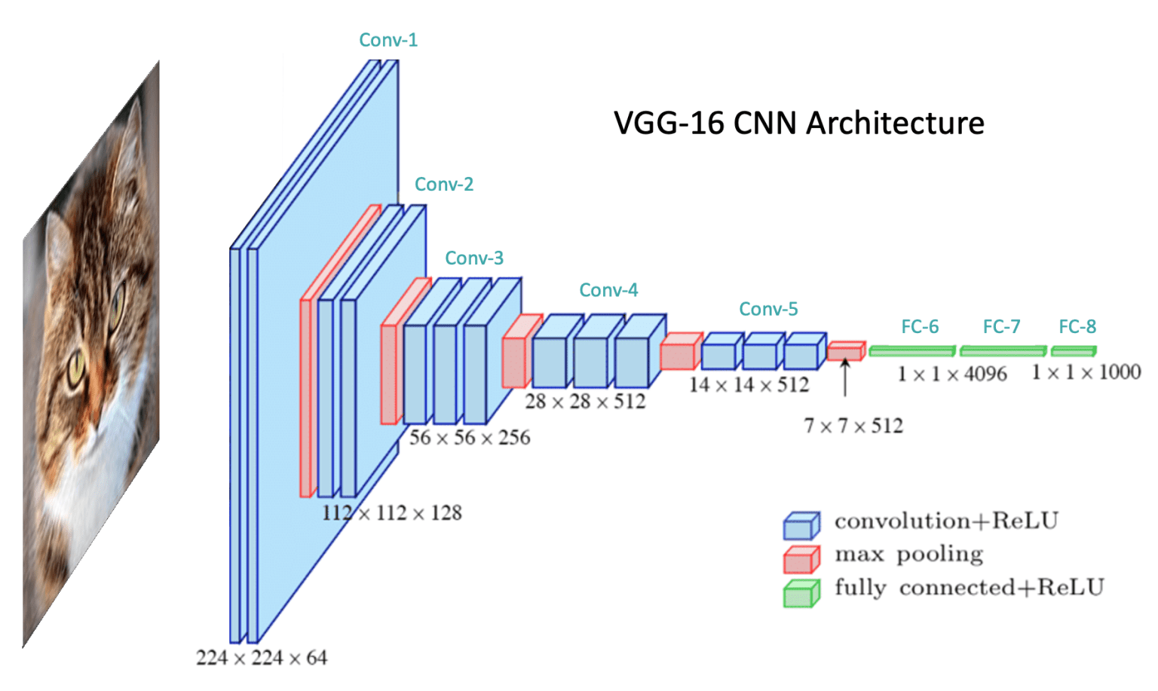
Project Overview & Objectives
Project Goal
Demonstrate transfer learning for CIFAR-10 using pre-trained VGG16.
Dataset: CIFAR-10
• 60,000 images (32x32 color)
• 10 classes: airplane, automobile, bird, cat, deer, dog, frog, horse, ship, truck
• 50,000 training + 10,000 test
Three Experimental Conditions
1. From Scratch — baseline CNN
2. Feature Extraction — frozen VGG16
3. Fine-Tuning — progressive unfreezing
Expected: Higher accuracy with faster convergence.
Tech Stack
• PyTorch / TensorFlow
• VGG16 (ImageNet pre-trained)
• GPU (CUDA)
• Google Colab
15

Slide 16
Dataset: CIFAR-10 Deep Dive
60K
32x32
10
Balanced
Total Images
Image Resolution
Classes
Class Distribution
50K train + 10K test
RGB color channels
6,000 images each
Equal samples per class
Preprocessing Pipeline
1
2
3
4
5
Resize
48x48 or 224x224
Normalize
[0, 1] range
Standardize
ImageNet mean/std
Encode
One-hot labels
Augment
Flip, rotation
CIFAR-10 classes: Airplane · Automobile · Bird · Cat · Deer · Dog · Frog · Horse · Ship · Truck
16

Slide 17
Model Architecture: VGG16 Adaptation
Original VGG16 (ImageNet)
Adapted VGG16 (CIFAR-10)
• 16 layers: 13 conv + 3 FC
• 138M parameters
• Input: 224x224x3
• Output: 1000 classes
• FC: 4096 -> 4096 -> 1000
• Conv base: FROZEN (feature extractor)
• Only ~2M trainable params
• Input: 48x48x3 (resized)
• Output: 10 classes
• New FC: 512 -> Dropout -> 10
Architecture Flow
Input 48x48x3
Conv Base (Frozen)
13 Conv Layers
Flatten
New Classifier
512 -> Dropout -> 10
10 Classes
The convolutional base acts as a powerful feature extractor, learning hierarchical features from edges to complex patterns.
17

Slide 18
Implementation: Feature Extraction Approach
Step 1: Load Pre-trained Model
Load VGG16 with ImageNet weights, exclude top classifier
Step 2: Freeze All Layers
Set layer.trainable = False for all conv layers
Step 3: Add Custom Classifier
GlobalAvgPool -> Dense(512, ReLU) -> Dropout(0.3) -> Dense(10, Softmax)
Step 4: Compile Model
Adam optimizer (lr=1e-3), categorical_crossentropy loss
Step 5: Train
Train for 20-30 epochs with early stopping. Only classifier weights update.
Python / Keras Pseudocode
# Step 1: Load base model
base_model = VGG16(
weights='imagenet',
include_top=False,
input_shape=(48,48,3))
# Step 2: Freeze layers
for layer in base_model.layers:
layer.trainable = False
# Step 3: Add classifier
x = base_model.output
x = GlobalAveragePooling2D()(x)
x = Dense(512, activation='relu')(x)
x = Dropout(0.3)(x)
pred = Dense(10, activation='softmax')(x)
model = Model(base_model.input, pred)
18

Slide 19
Implementation: Fine-Tuning Approach
PHASE 1: Feature Extraction
PHASE 2: Gradual Unfreezing
PHASE 3: Optional Deeper
• Train classifier with frozen backbone
• 10 epochs, lr=1e-3
• Establish baseline accuracy
• Conv layers unchanged
• Unfreeze from block5_conv1
• Lower lr to 1e-4
• Train for 10-15 epochs
• Deeper layers adapt
• Unfreeze block4 if needed
• Even lower lr: 1e-5
• Train for 5-10 epochs
• Fine-grained adaptation
Key Code: Gradual Unfreezing
# Unfreeze from block5_conv1 onwards
for layer in base_model.layers:
if layer.name == 'block5_conv1': break
layer.trainable = False
# ReduceLROnPlateau adapts LR when val_loss plateaus
# Progressive approach prevents catastrophic forgetting
19

Slide 20
Training Configuration & Hyperparameters
Parameter | Value
Optimizer | Adam
Learning Rate (classifier) | 1e-3
Learning Rate (fine-tuning) | 1e-4 to 1e-5
Loss Function | Categorical Cross-Entropy
Batch Size | 64
Epochs | 50 (with early stopping)
Early Stopping Patience | 5 epochs
LR Reduction Factor | 0.5 (patience: 3)
Input Size | 48x48 (resized from 32x32)
Hardware | GPU (CUDA)
Three Experimental Conditions
From Scratch
Train CNN from random init as baseline
Feature Extraction
Frozen VGG16 + trainable classifier only
Fine-Tuning
Progressive unfreezing with differential LR
All conditions use identical preprocessing, batch size, and data augmentation for fair comparison.
20

Slide 21
04
Results & Evaluation
Experimental results comparing training from scratch, feature extraction, and fine-tuning

Slide 22
Accuracy Comparison: Three Approaches
73%
84%
90%
From Scratch
Feature Extraction
Fine-Tuning
50 epochs, unstable convergence
20 epochs, stable training
30 epochs, best performance
Key Insights
• 10-17% accuracy gain
• Feature extraction: best efficiency
• Fine-tuning: highest accuracy
• Convergence reduced by 60%
22

Slide 23
Training Curves: Convergence Analysis
Convergence Analysis
From Scratch: Starts ~12% (random), climbs to ~78% train / ~73% val. Significant overfitting.
Feature Extraction: Starts ~45%, reaches ~88% train / ~84% val. Minimal overfitting — best stability.
Fine-Tuning: Starts ~50%, reaches ~94% train / ~90% val. Best final accuracy.
23

Slide 24
Per-Class Performance Analysis
Class Analysis
Best Performing
• Ship: 95.1%
• Automobile: 94.5%
• Frog: 93.8%
Distinct visual features
Most Challenging
• Cat: 82.3%
• Dog: 85.4%
• Bird: 87.1%
Fine-grained animal distinction
Mean Accuracy: 90.6%
Confusion Pattern: Primary misclassification pairs are cat-dog and bird-deer. Transfer learning improves worst-class accuracy by 8-12% vs. from-scratch.
24

Slide 25
Key Findings & Insights
01
02
03
Significant Accuracy Gain
Feature Extraction Efficiency
Progressive Fine-Tuning Wins
Transfer learning outperforms training from scratch by 10-17% on CIFAR-10 with limited data.
Excellent results with minimal training time — ideal for rapid prototyping.
Gradual unfreezing yields best accuracy while preventing catastrophic forgetting.
04
05
Generalizable Low-Level Features
Gap Widens with Less Data
Pre-trained models learn generalizable features (edges, textures, shapes) that transfer across diverse visual domains, from natural images to specialized tasks.
The gap between transfer learning and from-scratch training widens as dataset size decreases. On small datasets, transfer learning can outperform by 20-30%.
25

Slide 26
05
Conclusions & Future Directions
Summary of lessons learned and emerging trends in transfer learning

Slide 27
Challenges & Limitations of Transfer Learning
Negative Transfer
Domain Gap
Catastrophic Forgetting
When source and target domains are too different, transfer can hurt performance instead of helping.
Features learned on natural images may not transfer well to medical, satellite, or specialized domains.
Aggressive fine-tuning can destroy pre-trained knowledge. Requires careful learning rate management.
Model Bias
Computational Cost
Overfitting Risk
Pre-trained models inherit biases from source datasets, which can propagate to downstream tasks.
Large pre-trained models require significant inference resources for deployment.
Fine-tuning on very small datasets can lead to overfitting despite the regularization effect of transfer.
27

Slide 28
Future Directions in Transfer Learning
Foundation Models
GPT-4, CLIP, SAM enable zero/few-shot adaptation
Multi-Modal Transfer
Cross-modal knowledge transfer
Green AI
PEFT reduces compute by 90%+
Now
Emerging
Vision
Near Term
Future
Domain-Adaptive Pre-training
Intermediate fine-tuning on domain data
Federated TL
Collaborative transfer with privacy preserved
Also: Automated Transfer (AutoML selection) and Continual Learning (lifelong accumulation)
28

Slide 29
Thank You
Deep Learning Transfer Learning — Project Demonstration
Questions & Discussion
W17 L31 · Deep Learning Course · 2026 Spring

